Slide 1
King County House Price Analysis
Yukthi Papanna Suresh, Emily Lin, Caglar Kurtkaya

Slide 2
Problem Selection
House Price Prediction of King county the most populous county in Washington and 13th in USA
Dataset from Kaggle
Solution: Building a price prediction system using features
Task 1: Build regression model
Task 2: Build a clustering model using location

Slide 3
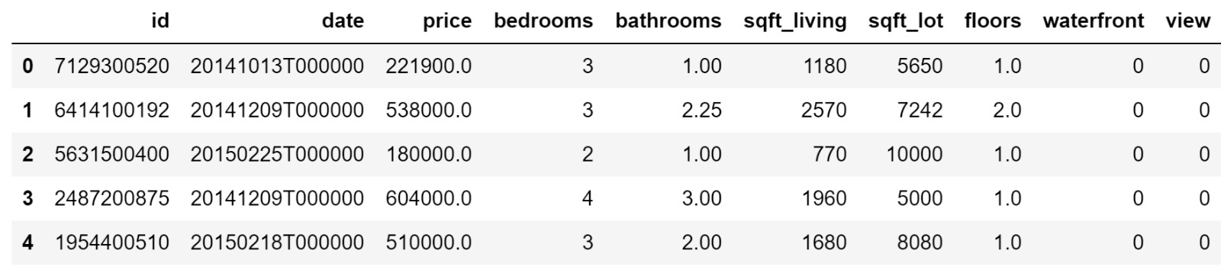
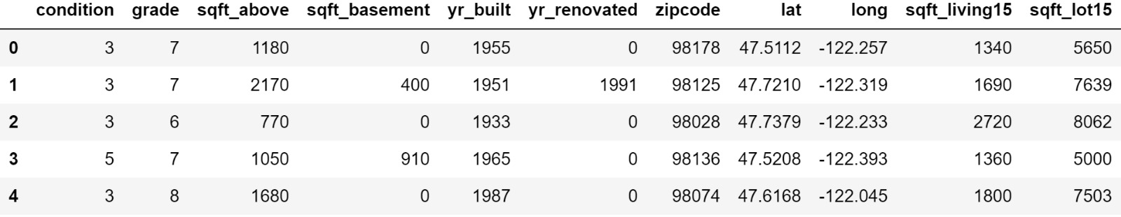
Initial Data-Frame

Slide 4
Pre-Processing
Trimmed date to year (Noise)
Null values analysis (Missing Values)
Create dummy variable for date (2014->0, 2015->1)
Removed outliers (Outlier)

Slide 5
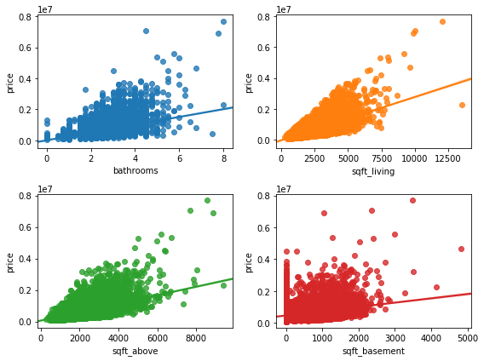
Exploratory Data Analysis

Slide 6
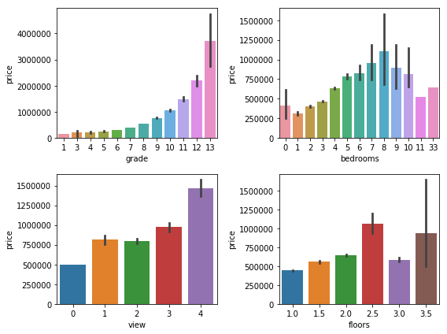
EXPLORATORY DATA Analysis cont.

Slide 7
Regression Models
Top 12 attributes (using SelectKBest)
Train, Test and Validation Set
StandardScaler fit Training set
Transformed Train, Test and Validation set (Mean of 0 and Standard deviation of 1)

Slide 8
Regression Cont.
Summary of the R-squared values of the models using important features
Model | Train R-square | Validation R-square | Test R-square
Random Forest Regressor | 0.9571038167086312 | 0.804736200215252 | 0.7864689753166656
KNN Regressor | 0.811655569838343 | 0.7648410447043974 | 0.734203076978137
Lasso | 0.6580630800394413 | 0.683640999182128 | 0.6536720919606233
Multiple Linear | 0.6580630942955326 | 0.6836439383426598 | 0.6536695752128876
Ridge | 0.6580630909744568 | 0.6836444387263839 | 0.653666585768011
Elastic Net | 0.6320709061022907 | 0.6541556803876882 | 0.6206226725909685
Decision Tree Regressor | 0.9993841300058871 | 0.6023396600684414 | 0.6195867930647317

Slide 9
Clustering Models
Custom Cluster
Price < 250000 – Light Blue
250000<price<500000 – Dark Blue
500000<price<1000000 – Green
1000000<price<3000000 – Yellow
3000000<price<5000000 – Light Red
Price>5000000 – Dark Red
K-means
6 clusters using important features
Ward’s Linkage
6 clusters using important features

Slide 10
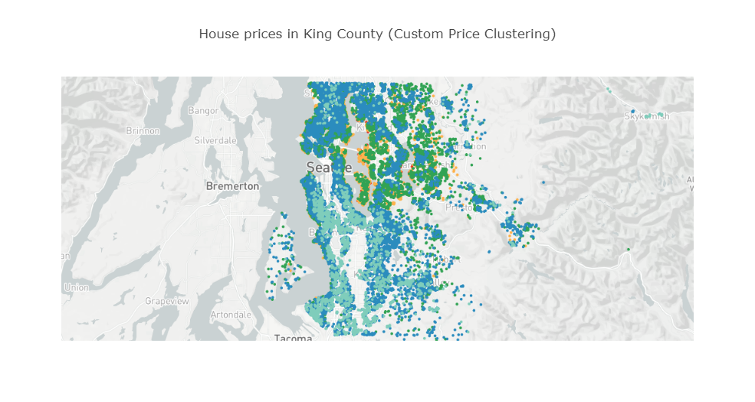

Slide 11
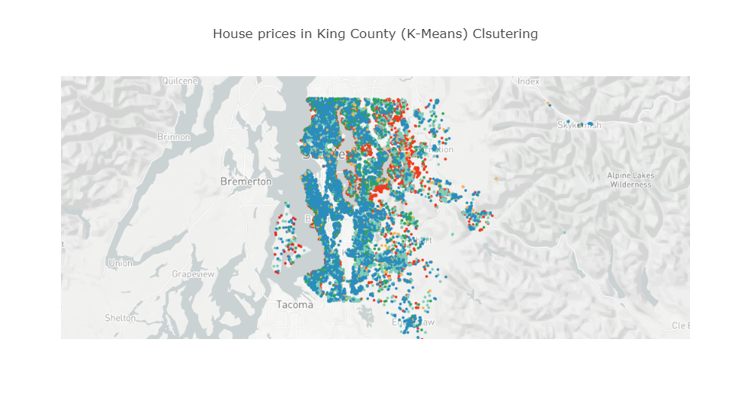

Slide 12
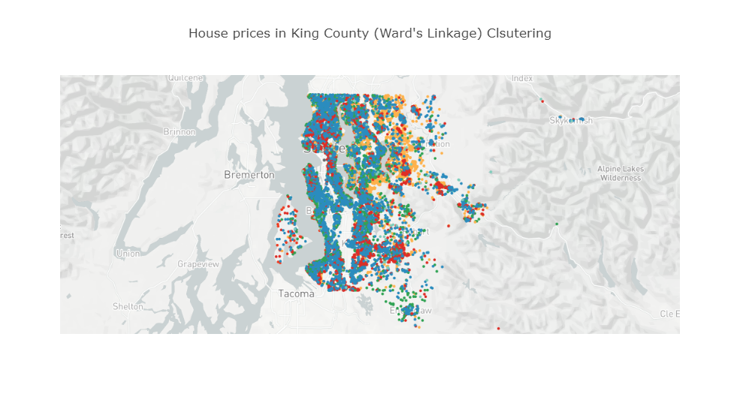

Slide 13
Conclusion
Good Regression models
Random Forest Regressor - 79% explanation is the variance of the dependent variable
Bad Clustering Models due to the no clear trend in clusters of data points

Slide 14
Thank You

